Slide 1


YULU : Pedal the Change Analysis
Tarushee Bhalla
🎨
🖌️

Slide 2




Project Analysis
Business Strategy and Recommendation
Introduction
PROJECT
YULU Insights
Data Cleaning with SQL
YULU Report : Visualization with Power BI
Data Analysis with SQL
Best Practices
Recommendation
Deeper Analysis with Power BI

Slide 3
INTRODUCTION
🚴 Hey everyone! Have you ever wondered why Yulu bikes are so popular?
Whether it's a spontaneous ride with friends or a convenient way to beat the traffic, Yulu bikes are becoming the go-to choice for many of us. But what’s driving this surge in popularity?
📈 Yulu's Growth:
Yulu is in a strong growth phase, gaining traction with urban commuters and weekend adventurers alike.
Challenges: Scaling operations while maintaining rider satisfaction and profitability is key.
🎯 Future Goals:
Optimize Fleet Management: Ensuring efficient use of resources.
Expansion: Aiming to grow in more cities and tap into untapped markets.
Cost-Effectiveness: Maintaining financial efficiency to sustain growth.
Leadership: Striving to become the dominant leader in sustainable urban mobility.
🔍 Data Insights:
We’ve analyzed ridership patterns, the impact of weather on business, and profitability trends.
From ideal weather conditions to peak profit timeframes, our data reveals a clear roadmap for Yulu’s future success.
Let’s ride through this journey 🚴‍♂️ and see how Yulu can keep rolling towards a sustainable, profitable future! 🌍

Slide 4
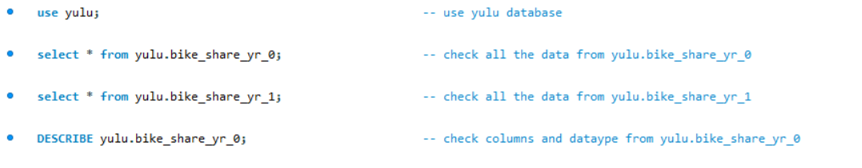
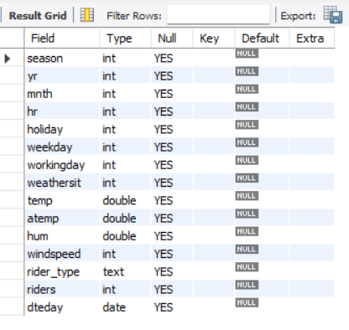
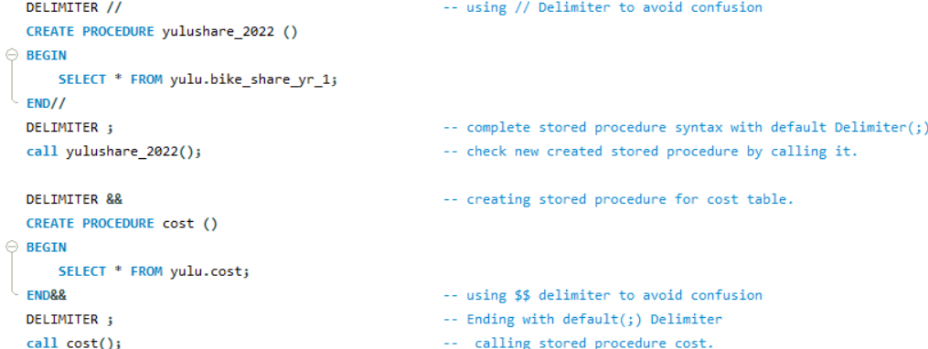
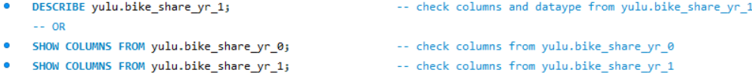
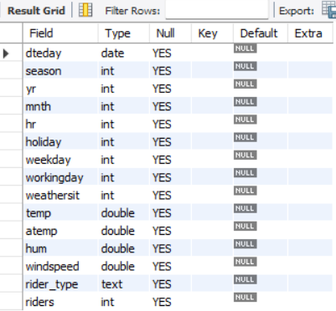
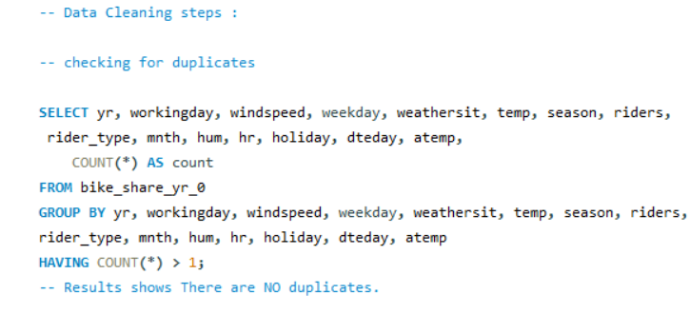
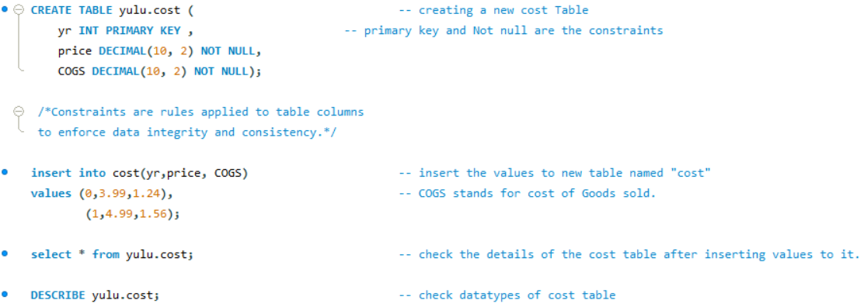

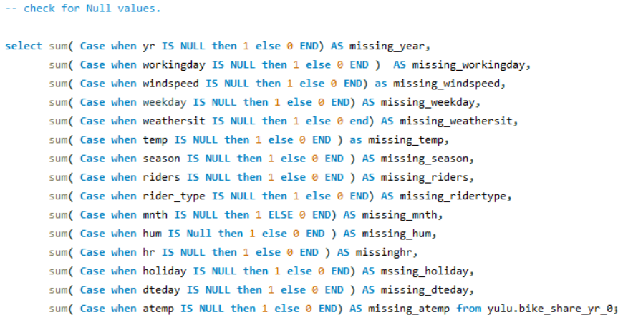
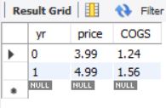
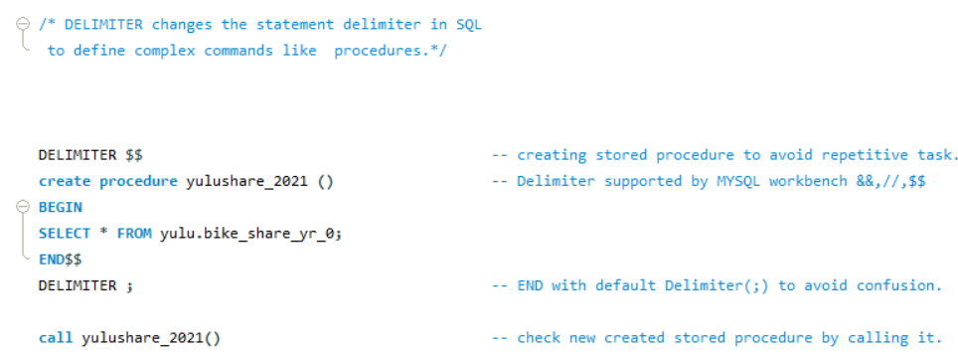
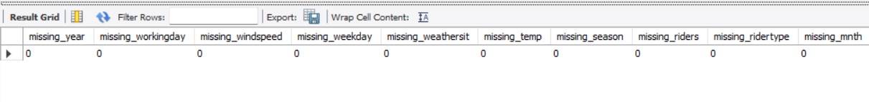
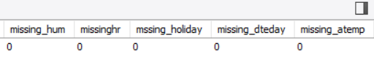
💻Structured Query Language(SQL) : Data cleaning🧹and Analysis📊

Slide 5
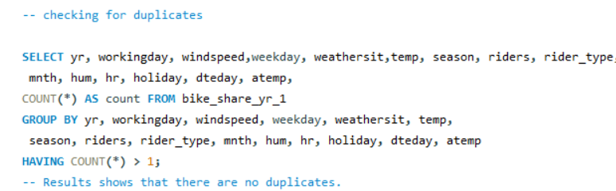
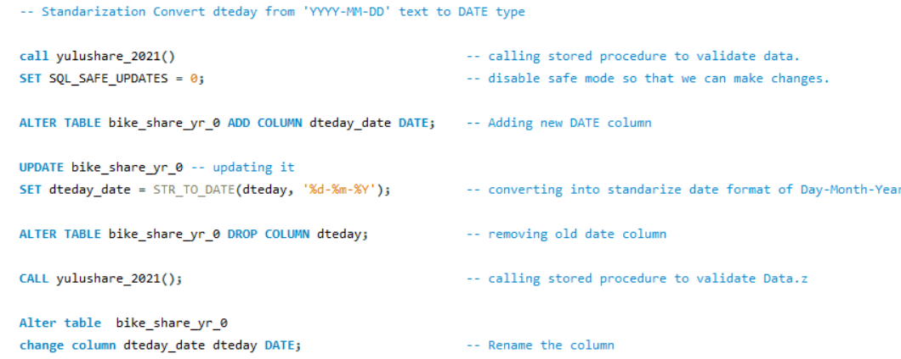
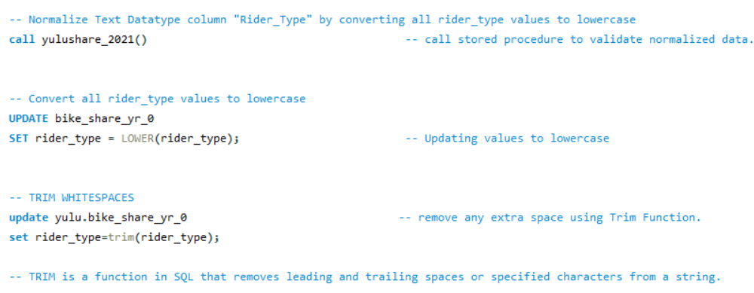
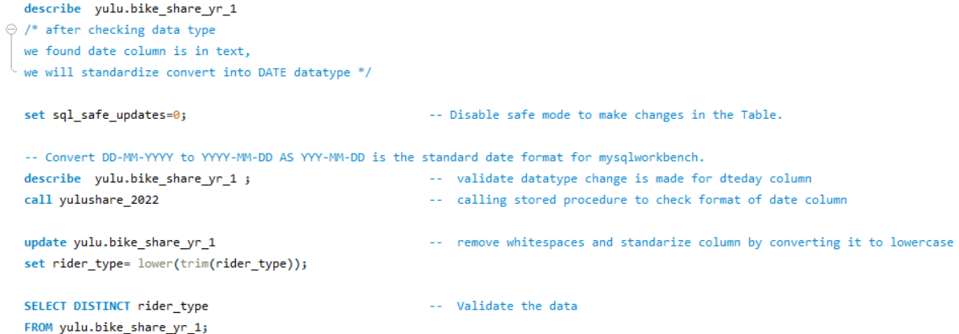
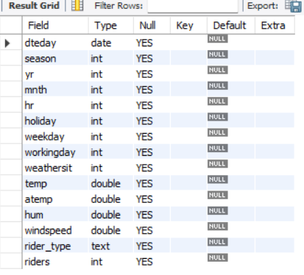
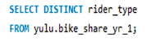
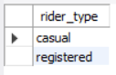
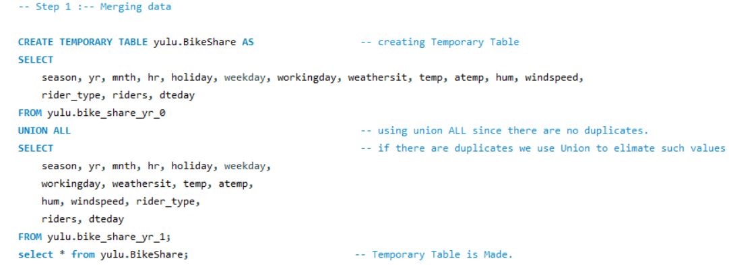
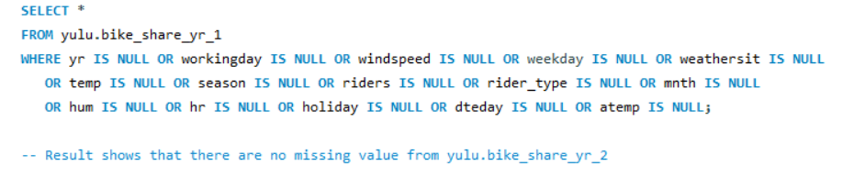

Slide 6
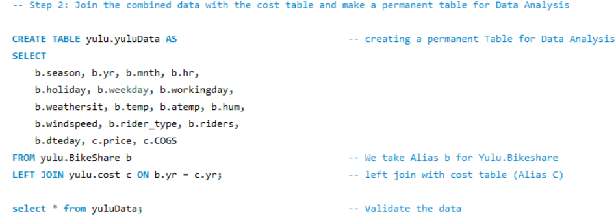
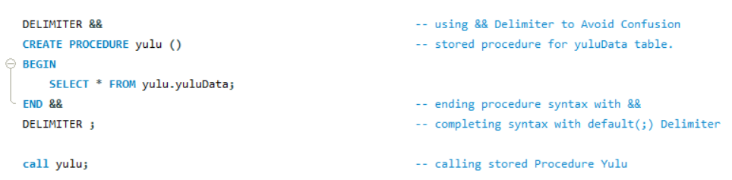
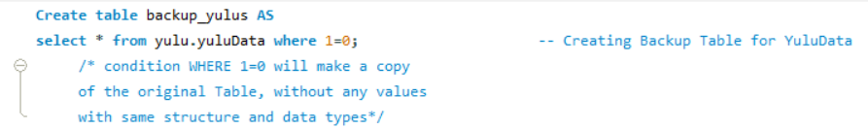
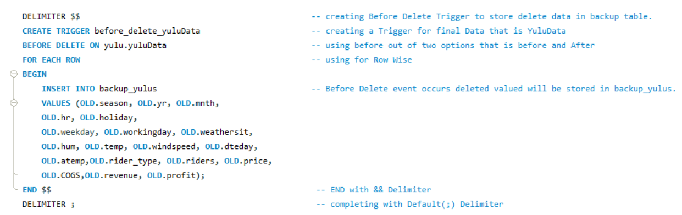
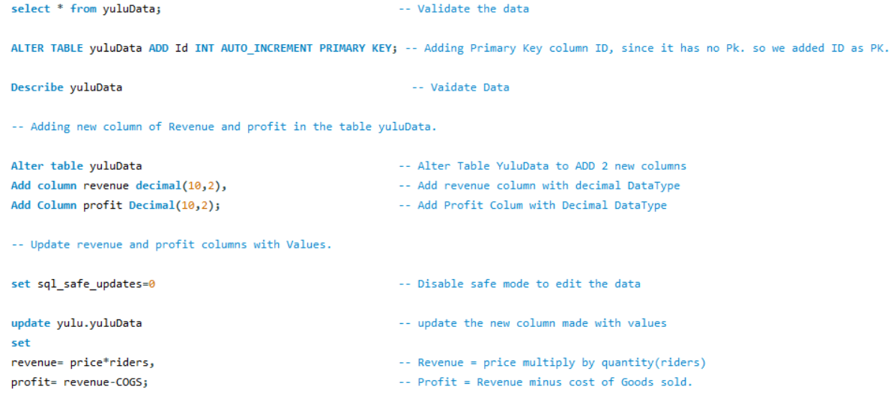
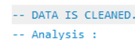
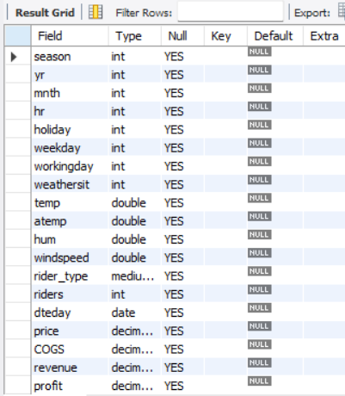
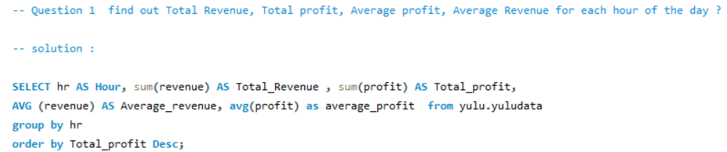
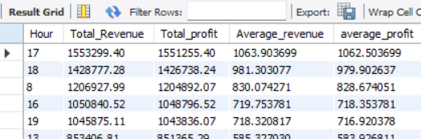
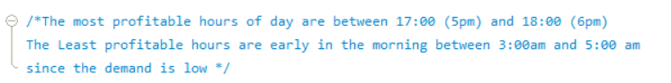

Slide 7
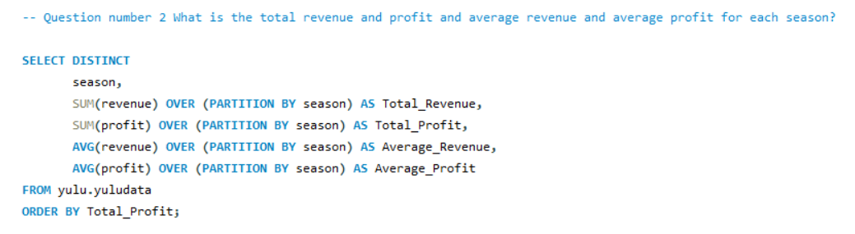
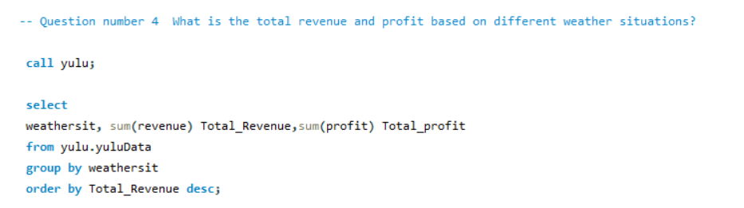
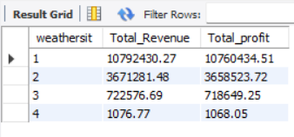
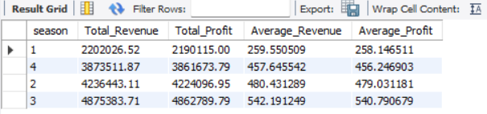
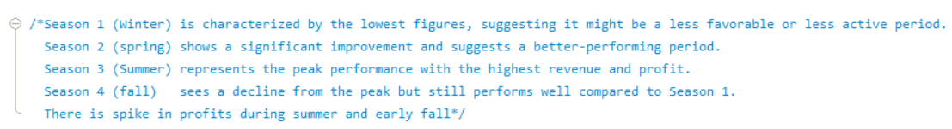
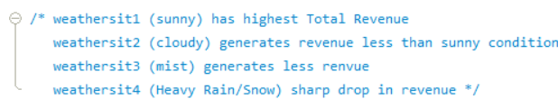
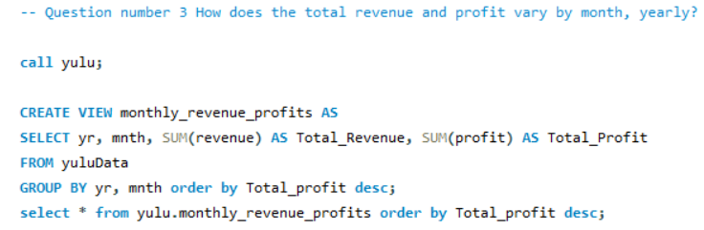
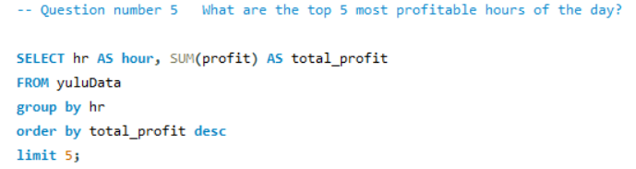
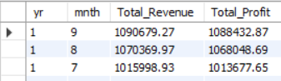
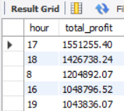
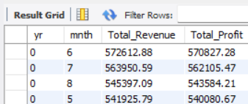
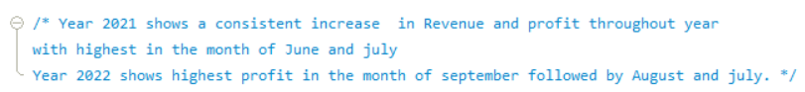
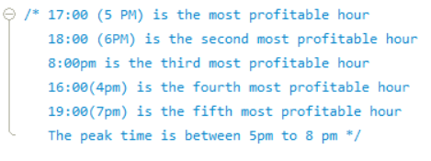

Slide 8
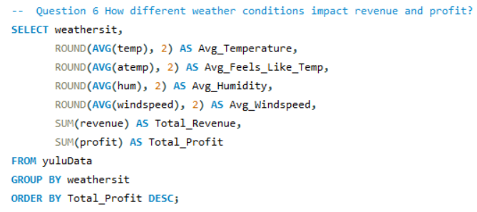
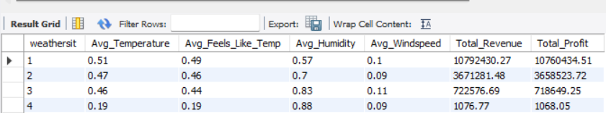
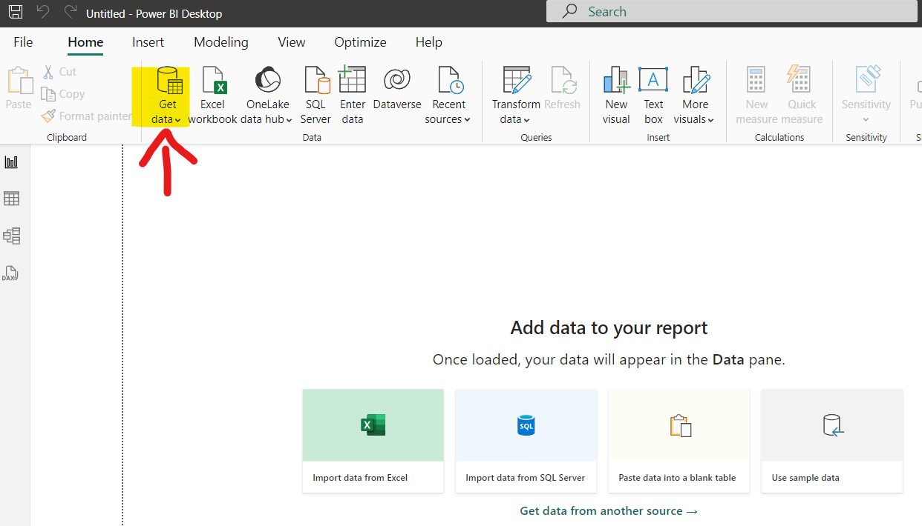
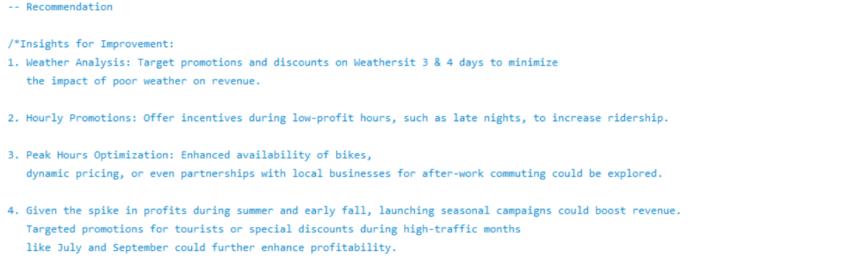
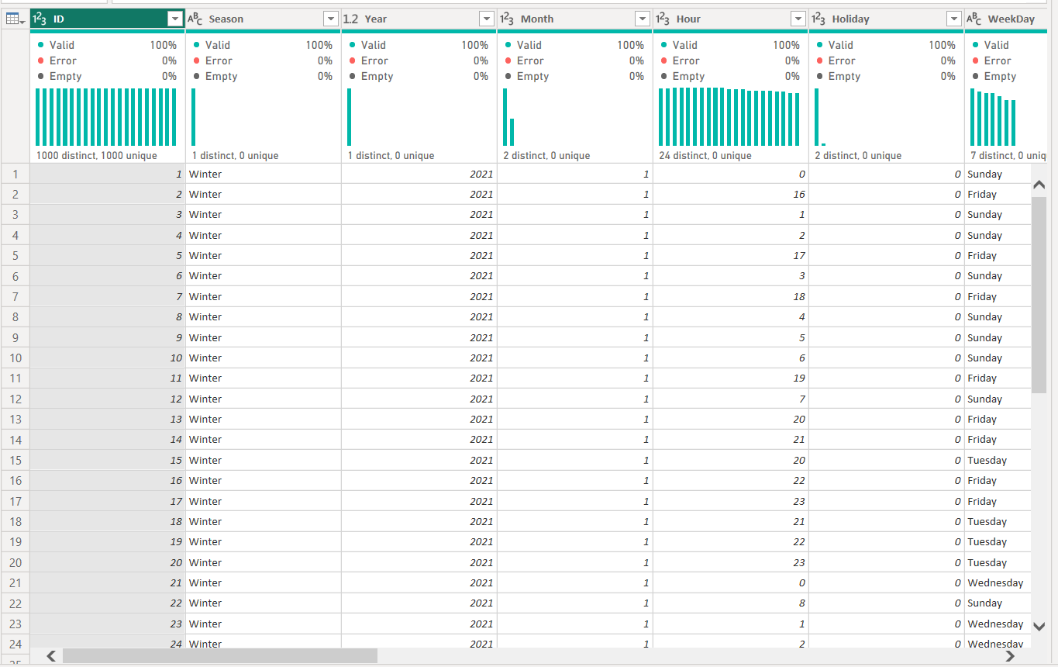
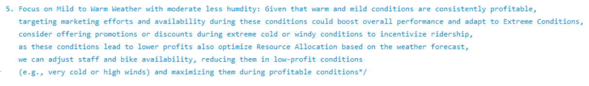
For Deeper Analysis and Visualization, we will use Power BI
💼 1. Load Data into Power BI:
Open Power BI Desktop.
Navigate to Home > Get Data, and choose your data source (Excel, SQL, CSV, etc.).
Select your file, and click Load to bring your data into Power BI. 🚀
📏 2. Check and Adjust Data Types:
Go to Data View (table icon on the left sidebar).
Review each column to ensure the correct data types (e.g., Date, Text, Integer).
If needed, click on the column and adjust its data type in the Modelling tab.
.

Slide 9



🗓️3. Create a Calendar Table
Go to the Modelling tab and click New Table.
In the formula bar, create a calendar table using the following DAX formula:
Calendar_Table =
ADDCOLUMNS(
CALENDAR(DATE(2021,1,1), DATE(2022,12,31)),
"Year", YEAR([Date]),
"Month_No", MONTH([Date]),
"Month Name", FORMAT([Date],"MMM"),
"Day", DAY([Date]),
"Week_Day", FORMAT([Date],"DDD"),
"Quarter", QUARTER([Date]),
"WeekdayNumber", WEEKDAY([Date], 2) – 1
🔗 5. Create Relationships in Power BI:
Navigate to Model View: Click on the model icon in the left sidebar.
Refine Connections: Connect your tables seamlessly for better insights and improved report performance.
📏4. Build Measures:
Average Revenue = AVERAGE(Yulu[Revenue])
Average_Profit = AVERAGE(Yulu[Profit])
Number of Records = COUNTROWS(Yulu)
Total Profit = SUM(Yulu[Profit])
Total Revenue = SUM(Yulu[Revenue])
YTD_Profit = TOTALYTD(SUM(Yulu[Profit]), Yulu[Date])
YTD_Revenue = TOTALYTD(SUM(Yulu[Revenue]), Yulu[Date])
📅 6. Create a Date Hierarchy in Power BI:
Prepare Date Fields: Ensure you have columns for Year, Quarter, Month, and Day (or create them if needed).
Build the Hierarchy:
Right-click on Year in the Fields pane and select New Hierarchy.
Drag Quarter, Month, and Day into this hierarchy.
Apply to Visuals:
Drag the hierarchy to your visuals.
🛠️ Use the drill-down options to seamlessly explore data across levels (Year ➡️ Quarter ➡️ Month ➡️ Day).

Slide 10


Best Practices for Power BI Dashboard
Design and Layout
🎨 Hex Codes for Custom Colors: Using hex codes in Power BI ensures precision and uniformity. Just access the Format pane, pick custom color, and input the hex code to maintain a sleek, consistent visual design.
📅 Calendar Table: A calendar table is essential for accurate time analysis—enabling calculations like YoY growth and MTD. This allows for precise date filtering and consistent time-based insights
🔘 Navigation & Syncing Slicers: Create buttons for seamless page navigation and sync slicers for consistent filtering across pages. Slicers enhance user interactivity by allowing custom data views.
🔍 Drill Down with Date Hierarchy: Implement drill-downs to explore data by year, quarter, month, or week for deeper insights.
🔢 Month Sorting: Use Month No to correctly sort Month Names in the Calendar Table for accurate reporting.
🔗 Action Options for Interactivity: Use the "Action" option to add hyperlinks to buttons, images, or shapes, making your Power BI dashboard more interactive. This allows users to navigate external pages, reports, or internal sections with ease.

Slide 11


Slide 12
🚴‍♂️ Yulu Insights: Maximizing Profits Through Seasonal, Weather, and Rider Behaviour 📊
1️⃣ Revenue Growth: 📈 Profits doubled, growing 106% YoY from $4.9M to $10.2M.
2️⃣ Top Season: ☀️ Summer brings in $4.9M revenue; Winter trails with $2.2M.
3️⃣ Weather Impact: 🌞 Sunny days generate $10.7M in profit, while 🌧️ rainy days contribute just $1K.
4️⃣ Peak Hours: ⏰ Most profits come between 5 PM - 7 PM, with a spike at 5 PM.
5️⃣ Humidity Effect: 💧 Low humidity drives 52% of revenue, while high humidity reduces profits.
6️⃣ Wind Impact: 🍃 Low winds = 99% of profit; high winds cut profitability.
7️⃣ Rider Insights: 👥 Registered Riders account for 81.25% of ridership!
8️⃣ Weekday vs. Weekend: 📅 70% of revenue comes from Weekdays; weekends make up 30%.
9️⃣ Marketing Opportunity: 🎯 Convert casual riders to registered for sustained growth

Slide 13


Business Strategies and Recommendation
Overall Performance Overview
Profit Growth: From your data, profit growth is evident when comparing year-over-year performance. Focus on how profit has increased by over 106% from Year 0 to Year 1, reinforcing the company’s growth.
Revenue Growth: Similarly, highlight that revenue has seen a sharp rise of over 106%, showing a parallel growth trend with profit.
Key Insight: Registered riders make up the majority of the customer base at 81.25%, a core market to sustain.
2. Seasonal Analysis
Best Performing Season:
Summer: The most lucrative season, generating around $4.9M, highlights a positive correlation between warm weather and ridership.
Actionable Insight: Focus promotional efforts during this season to maximize revenue.
Lowest Performing Season:
Winter: The total revenue significantly drops to $2.2M, likely due to the drop in temperature.
Actionable Insight: Consider offering promotions or discounts in winter to incentivize ridership despite the cold.

Slide 14
3. Weather Impact
Sunny Weather Advantage: With total revenue exceeding $10.7M on sunny days, the weather directly impacts rider engagement.
Impact of Poor Weather: Bad weather conditions like heavy rain see the sharpest decline in revenue, with only $1K generated.
Actionable Insight: Resource allocation and promotions should be adjusted during rainy seasons to maintain revenue.
4. Temperature Analysis
Profitable Temperature Ranges: The temperature between mild and warm ranges correlates with higher ridership and profits.
Actionable Insight: Use this knowledge to plan operations around expected weather and promote rides during ideal conditions.
5. Humidity and Windspeed Insights
Humidity: High humidity negatively affects profitability, while moderate to low humidity performs better.
Windspeed: High wind conditions severely cut into profits, indicating lower ridership on windy days.
Actionable Insight: Analyse humidity and wind patterns to predict rider behaviour and adjust availability.
6. Day and Hourly Insights
Peak Hours: Profitability spikes from 5 PM to 7 PM, showing a significant reliance on after-work commuters.
Low Profit Hours: The early morning hours (3 AM to 5 AM) show limited activity, suggesting these are good times for maintenance or operational adjustments
Actionable Insight: Target promotions for low-profit hours and increase focus on peak hours to optimize availability.

Slide 15
7. Weekday vs. Weekend Performance
Weekdays Dominate: Weekdays account for 69.68% of the total revenue, indicating a reliance on weekday commuters.
Weekend Use: Weekends, although less profitable (30.31% of total revenue), show potential for increased casual ridership.
Actionable Insight: Tailor weekday promotions to commuters and weekend promotions to leisure riders.
8. Rider Retention Recommendations
Convert Casual Riders: Focus on converting more casual riders to registered riders with loyalty programs, discounts, or premium offers.
Actionable Insight: This could significantly increase long-term profitability by increasing customer lifetime value.
9. Marketing and Promotions Strategy
Low-Profit Hours: Offer targeted promotions for early morning and late-night hours to boost ridership during off-peak times.
Seasonal Campaigns: Run high-impact campaigns during peak seasons like Summer to attract even more riders.
Actionable Insight: Leverage insights from high-performance months to maximize profit through marketing.
10. Weather-Based Resource Allocation
Bike Availability: Use weather predictions to optimize the number of bikes available during ideal weather conditions and reduce supply during poor weather.
Actionable Insight: By anticipating weather changes, better allocation can help maintain profits.

Slide 16


